Slide 1
Loop

Slide 2
Acknowledgement
The contents (figures, concepts, graphics, texts etc.) of the slides are gathered and utilized from the books mentioned and the corresponding PPTs available online:
Books:
Let Us C, Yashawant Kanetkar, BPB Publications.
The C Programming Language, B. W. Kernighan, D. Ritchie, Pearson Education India.
Web References:
Problem Solving through Programming in C, Anupam Basu, NPTEL Video Lectures. Link: https://nptel.ac.in/courses/106/105/106105171/
Compile and Execute C Online (GNU GCC v7.1.1), Link: https://www.tutorialspoint.com/compile_c_online.php
Disclaimer: The study materials/presentations are solely meant for academic purposes and they can be reused, reproduced, modified, and distributed by others for academic purposes only with proper acknowledgements.

Slide 3
Chapter Objective
To learn about different types of Control Statements

Slide 4
Chapter Topics
Repetition or Iteration structure - for statement, continue statement, nested loop, while loop

Slide 5
The programs that we have developed so far used either
a sequential – the calculations were carried out in a fixed order
or
a decision control instruction- an appropriate set of instructions were executed depending upon the outcome of the condition being tested (or a logical decision being taken).
The flexibility of the computer lies in its ability to perform a set of instructions repeatedly.
This involves repeating some portion of the program either a specified number of times or until a particular condition is being satisfied .
This is done by loops

Slide 6
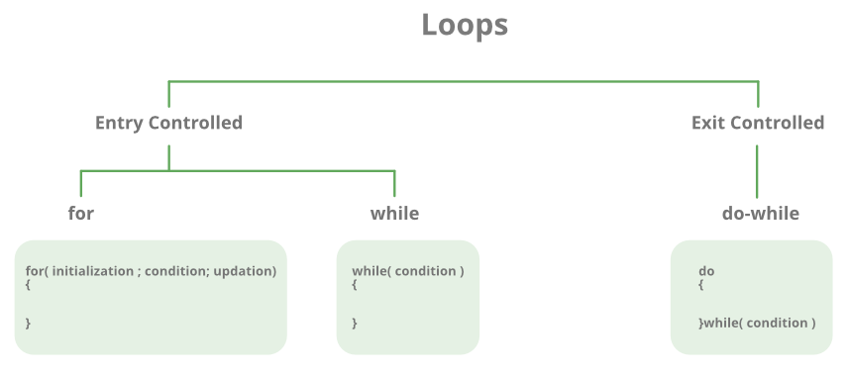
There are mainly two types of loops in C Programming:
Entry Controlled loops: In Entry controlled loops the test condition is checked before entering the main body of the loop. For Loop and While Loop is Entry-controlled loops.
Exit Controlled loops: In Exit controlled loops the test condition is evaluated at the end of the loop body. The loop body will execute at least once, irrespective of whether the condition is true or false. do-while Loop is Exit Controlled loop.

Slide 7
C Control Structure Looping
w h ile d o - w h ile
There are three methods by which we can repeat a part of a program.
(a)Using a for statement
(b) Using a while statement
(c) Using a do-while statement
fo r
n - tim e s

Slide 8
Operators
A unary operator has one operand
Post and Pre increment and decrement
a++,b--,++a,--b
» a = a++;
A binary operator has two operands
a = b+c
A ternary operator has three operands
boolean-expr ? expression-1 : expression-2

Slide 9
The ternary operator
boolean-expr ? expression-1 : expression-2
This is like if-then-else for values rather than for statements
If the boolean-expr evaluates to true, the result is
expression-1, else it is expression-2
Example: max = a > b ? a : b ; sets the variable max
to the larger of a and b
expression-1 and expression-2 need not be the same type, but either result must be useable (not a “void” function)
The ternary operator is right associative!
– To avoid confusion, use parentheses if your expression has more than one ternary operator
6

Slide 10
Increment and Decrement Operators
The increment operator ++ adds 1 to its operand, and the decrement operator - - subtracts 1.
Increment
It is used to increment the value of the variable by 1. The increment can be done in two ways:
1. prefix increment: In this method, the operator precedes the operand (e.g., ++a). The value of the operand will be altered before it is used.
int a = 1;
int b = ++a; // b = 2
2. postfix increment: In this method, the operator follows the operand (e.g., a++). The value of operand will be altered after it is used.
int a = 1;
int b = a++; // b = 1
int c = a; // c = 2

Slide 11
Increment and Decrement Operators
The increment operator ++ adds 1 to its operand, and the decrement operator - - subtracts 1.
Decrement:
It is used to decrement the value of the variable by 1. The decrement can be done in two ways:
1. prefix decrement: In this method, the operator precedes the operand (e.g., – -a). The value of the operand will be altered before it is used.
int a = 1;
int b = --a; // b = 0
2. postfix decrement: In this method, the operator follows the operand (e.g., a- -). The value of the operand will be altered after it is used.
int a = 1;
int b = a--; // b = 1
int c = a; // c = 0

Slide 12
1. main( )
{
int a=5; printf("a=%d”,a++);
}
2. main()
{
int a=5;
3. main()
{
int a=5;
4. main()
{
int a=5; printf("a=%d”,--a);
}
printf("a=%d",++a); printf("a=%d“,a--);
} }
6. main()
{
int a=5; printf("a=%d",a++);
5. main()
{
int a=5;
printf ("%d %d %d", a++, a++, ++a);
printf("a=%d",++a);
printf("a=%d",a++);
}
7. main( )
{
int a=5; printf("a=%d",a--);
printf("a=%d“,--a);
printf("a=%d",a--);
}

Slide 13
1. main( )
{
int a=5; printf("a=%d”,a++);
}
2. main()
{
int a=5;
3. main()
{
int a=5;
4. main()
{
int a=5; printf("a=%d”,--a);
}
printf("a=%d",++a); printf("a=%d“,a--);
} }
6. main()
{
int a=5; printf("a=%d",a++);
5. main()
{
int a=5;
printf ("%d %d %d", a++, a++, ++a);
printf("a=%d",++a);
printf("a=%d",a++);
}
7. main( )
{
int a=5; printf("a=%d",a--);
printf("a=%d“,--a);
printf("a=%d",a--);
}
1. a=5
2. a=6
3. a=5
4. a=4
5. 7 6 8
6. a=5 a= 7 a=7
7. a=5 a=3 a=3

Slide 14
The while Statement
The while Statement Example
Structure
while (a < b)
{
while(expression)
statement;
while(expression)
{
statement_1; statement_2;
}
or
printf("%d\n", a);
a = a + 1;
}
* Operation: expression is evaluated and if TRUE then statement (or statement_1 and statement_2) is executed. The evaluation and executions sequence is repeated until the expression evaluates to be FALSE. If the expression is initially FALSE then statement is not executed at all.

Slide 15
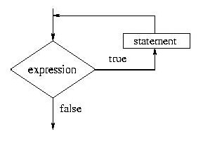
Flowchart of a while Loop
The syntax of a while loop is as follows:
initialization_expression;
while (test_expression)
{
// body of the while loop
update_expression;
}

Slide 16
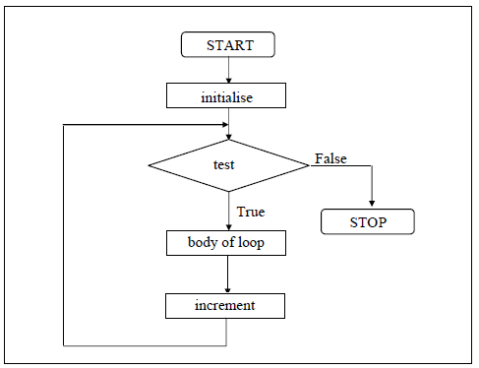

Slide 17
Understanding a while loop
b=1;
While(b<2)
{
blah blah b=b+1;
}
blah blah
When the computer reaches while statement, it tests to see if the Boolean expression is true. If true, it jumps into the block of code immediately below the while statement

Slide 18
Understanding a while loop
b=1;
While(b<2)
{
blah blah b=b+1;
}
blah blah
When the computer reaches last line in the while loop’s block of code, it jumps back up to the
while statement. It re-tests the
Boolean expression. If still true, it enters the block of code again.

Slide 19
Understanding a while loop
b=1;
While(b<2)
{
blah blah b=b+1;
}
blah blah
When the Boolean expression becomes false , the computer skips the while loop statement’s block of code and continues with the remainder of the program.

Slide 20
The general form of while is as shown below:
initialise loop counter ;
while ( test loop counter using a condition )
{
do this ;
and this ;
increment loop counter ;
}
The statements within the while loop would keep on getting executed till the condition being tested remains true.
When the condition becomes false, the control passes to the first statement that follows the body of the while loop.
In place of the condition there can be any other valid expression. So long as the expression evaluates to a non-zero value the statements within the loop would get executed.
The condition being tested may use relational or logical operators as shown in the following examples:
while ( i <= 10 )
while ( i >= 10 && j <= 15)

Slide 21
As a rule the while must test a condition that will eventually become false, otherwise the loop would be executed forever.
main( )
{ int i = 1 ;
while ( i<=10)
{
printf ( “%d\n", i ) ;
}
}
The correct form:
main( )
{ int i = 1 ;
while ( i<=10)
{
printf ( “%d\n", i ) ;
i=i+1;
}
}

Slide 22
loop counter, can even be decremented.
main( )
{ int i = 10 ;
while ( i>5)
{
printf ( “%d\n", i ) ;
i=i-1;
}
}
loop counter, can be float also.

Slide 23
Looping: A Real Example
Let's say that you would like to create a program that prints a Fahrenheit-to-Celsius conversion table. This is easily accomplished with a for loop or a while loop:
main()
{
int a; a = 0;
while (a <= 100)
{
printf(“%d degrees F = %d degrees C\n", a, (a - 32)
* 5 / 9);
a = a + 10;
}
}

Slide 24
main( )
{
int i = 1,sum=0;
<=100 ){
main( )
{
int i = 100,sum=0; while(i >=1 ){
sum=sum+i; printf(“Sum=%d \t &
i=%d\n”,sum,i--);
}}
while(i
sum=sum+i; printf(“Sum=%d \t &
i=%d\n”,sum,i++);
}}
main( )
{
int i = 1,sum=0;
main( )
{
int i = 100,sum=0; while(i >=1 ){
sum=sum+i; printf(“Sum=%d \t &
i=%d\n”,sum,i=i- 5);
}}
while(i <=100 ){ sum=sum+i;
printf(“Sum=%d \t & i=%d\n”,sum,i=i+5
);
}}

Slide 25
main( )
main( )
{
int i = 1,sum=0; while(i <=100 ){ if(i%2==1)
{
sum=sum+i;
}
printf(“Sum=%d \t & i=%d\n”,sum,i++);
}
}
{
int i = 1,sum=0;
while(i <=100 ){
if(i%2==0)
{
sum=sum+i;
}
printf(“Sum=%d \t &
i=%d\n”,sum,i++);
}
}

Slide 26
main( ) |  | main( )
{ |  | {
int i = 1,sum=0; |  | int i = 100,sum=0;
while(i <=100 ){ |  | while(i >=1){
if(i%2==0 && i%5==0) |  | if(i%2==0 && i%5==0 && i%10==0)
{ |  | {
sum=sum+i; |  | sum=sum+i;
} |  | printf("Sum=%d \t & i=%d\n",sum,i);
printf(“Sum=%d \t | & | }//bracket for if
i=%d\n”,sum,i++); _{i=i-1;}
} }//bracket |  |  | for | while
} }//bracket |  |  | for | main

Slide 27
Example:
Calculating a factorial 5!. The factorial n! is defined as n*(n-1)!
main() {
/* declaration */ int i, f, n;
/* initialization */ i = 1;
f = 1;
/* processing */
printf(“Please input a number\n”);
scanf(“%d”, &n);
while (i <= n) {
f=f*i;
i++;
}.
/* termination */
printf(“factorial %d! = %d\n", n, f);
}

Slide 28
do-while Loop
A do while loop is another type of repetition statement.
It is exactly the same as the while loop except it initially performs operations and then evaluates the logical expression of the loop to determine what should happen next.
This type of loop is referred to as an exit condition loop sequence. Normally with a while loop, some part of the logical expression in the loop must be initialized before execution of the loop.

Slide 29
do-while Loop
The syntax of a do-while statement is as follows:
do
statement while(expression);
The evaluation of the controlling expression takes place after each execution of the loop body.
The loop body is executed repeatedly until the return value of the controlling expression is equal to 0.

Slide 30
The do-while Statement
Structure
do
{
statement;
} while(expression);
do {
printf("%d\n", a);
a = a + 1;
} while (a < b);
Operation: Similar to the while control except that statement is executed before the expression is evaluated. This guarantees that statement is always executed at least one time even if expression is FALSE.

Slide 31
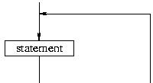
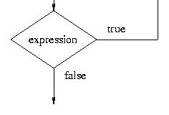
Flowchart of a do-while loop
The syntax of a do-while statement is as follows:
do
statement while(expression);

Slide 32
WAP to to calculate the square of a number until the user enters No

Slide 33
/* Execution of a loop an unknown number of times */
main( ) {
char another ; int num ;
do
{
printf ( "Enter a number " ) ;
scanf ( "%d", &num ) ;
printf ( "square of %d is %d", num, num * num ) ;
printf ( "\nWant to enter another number y/n " ) ;
scanf ( " %c", &another ) ;
} while ( another == 'y' ) ;
}
And here is the sample output...
Enter a number 5
square of 5 is 25
Want to enter another number y/n y
Enter a number 7
square of 7 is 49
Want to enter another number y/n n

Slide 34
Example:
int i = 0; do {
printf(“%d i++;
} while(i < 5);
”, i);
Output:
0 1 2 3 4

Slide 35
– What is the output of the following example?
Example:
int i = 10; do {
printf(“%d ”, i); i++;
} while(i < 5);

Slide 36
WAP to calculate the sum of integer (10 numbers max)
If the user enters a negative number, the loop terminates
Output
Enter n0: 2
Enter n1: 3
Enter n2: 5
Enter n3: 7
Enter n4: -3
Sum = 17.00

Slide 37
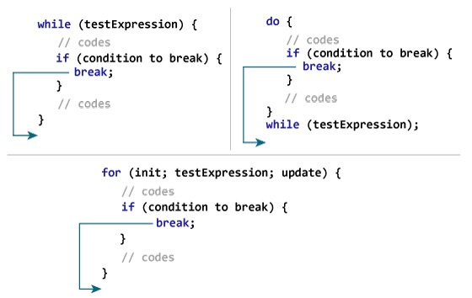
How break statement works?

Slide 38
WAP to calculate the sum of integer (10 numbers max)
If the user enters a negative number, the loop terminates
#include <stdio.h>
int main()
{
int i=0; float number, sum = 0.0;
while(i<10)
{
printf("Enter n%d: ", i);
scanf("%f", &number); // if the user enters a negative number, break the loop
if (number < 0.0)
{
break;
}
sum += number; // sum = sum + number;
i++; }
printf("Sum = %f", sum);
return 0;
}
Output
Enter n0: 2
Enter n1: 3
Enter n2: 5
Enter n3: 7
Enter n4: -3
Sum = 17.00

Slide 39
WAP to calculate the sum of numbers (10 numbers max)
If the user enters a negative number, it's not added to the result
Output
Enter n0: 1
Enter n1: 1
Enter n2: 1
Enter n3: -1
Enter n3: 1
Enter n4: 1
Enter n5: 1
Enter n6: 1
Enter n7: 1
Enter n8: 1
Enter n9: 1
Sum = 10.00

Slide 40
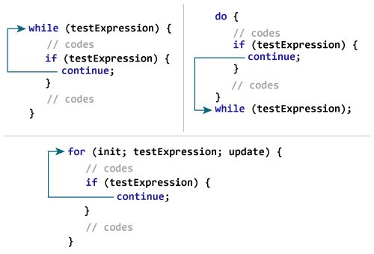
How continue statement works?

Slide 41
WAP to calculate the sum of numbers (10 numbers max)
If the user enters a negative number, it's not added to the result
#include <stdio.h>
int main()
{
int i=0; float number, sum = 0.0;
while(i<10)
{
printf("Enter n%d: ", i);
scanf("%f", &number); // if the user enters a negative number, it's not added to the result
if (number < 0.0)
{
continue;
}
sum += number; // sum = sum + number;
i++; }
printf("Sum = %f", sum);
return 0;
}

Slide 42
Exercise
# include <stdio.h>
int main( )
{
int x = 4, y, z ;
y = --x ;
z = x-- ;
printf ( "%d %d %d\n", x, y, z ) ;
return 0 ;
}
2 3 3

Slide 43
Exercise
# include <stdio.h>
int main( )
{
int x = 4, y = 3, z ;
z = x-- - y ;
printf ( "%d %d %d\n", x, y, z ) ;
return 0 ;
}
3 3 1

Slide 44
Exercise
# include <stdio.h>
int main( )
{
int i ;
while ( i = 10 )
{
printf ( "%d\n", i ) ;
i = i + 1 ;
}
return 0 ;
}
10
10
.
.
.
.

Slide 45
Exercise
# include <stdio.h>
int main( )
{
int j = 1 ;
while ( j <= 255 ) ;
{
printf ( "%c %d ", j, j ) ;
j++;
}
return 0 ;
}
No output

Slide 46
Exercise
#include<stdio.h>
int main()
{
int a = 0;
do
{
printf("Know Program");
} while(a);
return 0;
}
Know Program

Slide 47
The for Loop
A for loop is another way to execute instructions that need to be repeated in C (repetition structure).
The for allows us to specify three things about a loop in a single line:
Setting a loop counter to an initial value.
Testing the loop counter to determine whether its value has reached the number of repetitions desired.
Increasing the value of loop counter each time the program segment within the loop has been executed.
Ex:
for ( expression1; expression2; expression3 )
stmt(s);
where stmt(s) is a single or compound statement. expression1 is used to initialize the loop; expression2 is used to determine whether or not the loop will continue; expression3 is evaluated at the end of each iteration or cycle.

Slide 48
The for Statement
Structure:
for(expr1; expr2; expr3)
{
statement;
}
Operation: The for loop in C is simply a shorthand way of expressing a while statement:
expr1; while(expr2)
{
statement; expr3
}

Slide 49
C Errors to Avoid
Putting = when you mean == in an if or while statement
Forgetting to increment the counter inside the while loop - If you forget to increment the counter, you get an infinite loop (the loop never ends).
Accidentally putting a ; at the end of a for loop or if statement so that the statement has no effect - For example:
for (x=1; x<10; x++); printf("%d\n",x);
only prints out one value because the semicolon after the for statement acts as the one line the for loop executes.

Slide 50
For Loop
The syntax of a for statement is as follows:
for(initialise counter ; test counter ; increment counter)
{
statement
}
Example: factorial of n numbers
main() {
int i, f, n;
i = 1;
f = 1;
/* processing */ printf("Please input a number\n"); scanf("%d", &n);
for (i = 1; i <= n; i++)
{
f *= i;
}
/* termination */
printf("factorial %d! = %d\n", n, f);}

Slide 51

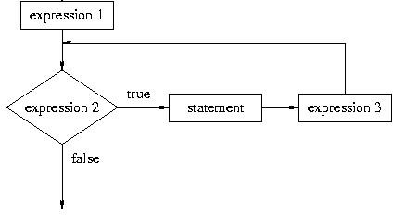
Flowchart of a for Loop
The syntax of a for loop is as follows:
for(expression1; expression2; expression3) statement

Slide 52
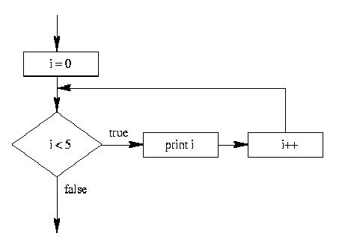
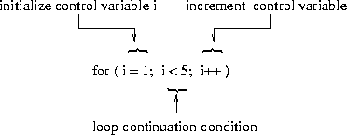
int i;
for(i = 0; i < 5; i++)
{
printf(“%d ”, i);
}
Example:
Output:
0 1 2 3 4

Slide 53
Calculating a factorial 5!. The factorial n! is defined as n*(n-1)!
Example:
main() {
int i, f=1, n;
printf(“Please input a number\n”); scanf(“%d”, &n);
for(i=1; i<=n; i++)
{
f = f*i;
}
printf(“factorial %d! = %d\n", n, f);
}
Execution and Output:
5
factorial 5! = 120

Slide 54
Valid for loops
It is important to note that the initialization, testing and incrementation part of a for loop can be replaced by any valid expression.
Thus the following for loops are perfectly ok.
for ( i = 10 ; i ; i -- )
printf ( "%d", i ) ;
for ( i = 1; i <=10 ; printf ( "%d",i++ )) ;
for ( scanf ( "%d", &i ) ; i <= 10 ; i++ )
printf ( "%d", i ) ;

Slide 55
Valid for loops
Example shows some programs to print numbers from 1 to 10 in different ways.
main( )
{
int i ;
for ( i = 1 ; i <= 10 ; i = i + 1 )
printf ( "%d\n", i ) ;
}
Note that the initialisation, testing and incrementation of loop counter is done in the for statement itself. Instead of i = i + 1, the statements i++ or i += 1 can also be used.
Since there is only one statement in the body of the for loop, the pair of braces have been dropped. As with the while, the default scope of for is the immediately next statement after for.

Slide 56
Valid for loops
Example shows some programs to print numbers from 1 to 10 in different ways.
(b) main( )
{
int i ;
for ( i = 1 ; i <= 10 ; )
{
printf ( "%d\n", i ) ;
i = i + 1 ;
}
}
Here, the incrementation is done within the body of the for loop and not in the for statement. Note that inspite of this the semicolon after the condition is necessary.

Slide 57
Valid for loops
Example shows some programs to print numbers from 1 to 10 in different ways.
(c) main( )
{
int i = 1 ;
for ( ; i <= 10 ; i = i + 1 )
printf ( "%d\n", i ) ;
}
Here the initialisation is done in the declaration statement itself, but still the semicolon before the condition is necessary.
(d) main( )
{
int i = 1 ;
for ( ; i <= 10 ; )
{
printf ( "%d\n", i ) ;
i = i + 1 ;
}
}
Here, neither the initialisation, nor the incrementation is done in the for statement, but still the two semicolons are necessary.

Slide 58
Valid for loops
(e) main( ) {
int i ;
for ( i = 0 ; i++ < 10 ; )
printf ( "%d\n", i ) ;
}
Here, the comparison as well as the incrementation is done through the same statement, i++ < 10. Since the ++ operator comes after i firstly comparison is done, followed by incrementation. Note that it is necessary to initialize i to 0.
(f) main( )
{
int i ;
for ( i = 0 ; ++i <= 10 ; )
printf ( "%d\n", i ) ;
}
Here, both, the comparison and the incrementation is done through the same statement, ++i <= 10. Since ++ precedes i firstly incrementation is done, followed by comparison. Note that it is necessary to initialize i to 0.

Slide 59
Nesting of Loops
The way if statements can be nested, similarly whiles and fors can also be nested. To understand how nested loops work, look at the program given below:
/* Demonstration of nested loops */
main( )
{
int r, c, sum ;
for ( r = 1 ; r <= 3 ; r++ ) /* outer loop */
{
for ( c = 1 ; c <= 2 ; c++ ) /* inner loop */
{
sum = r + c ;
printf ( "r = %d c = %d sum = %d\n", r, c, sum ) ;
}
}
}
As you can see, the body of the outer for loop is indented, and the body of the inner for loop is further indented. These multiple indentations make the program easier to understand.

Slide 60
Nesting of Loops
main( )
{
int r, c, sum ;
for ( r = 1 ; r <= 3 ; r++ ) /* outer loop */
{
for ( c = 1 ; c <= 2 ; c++ ) /* inner loop */
{
sum = r + c ;
printf ( "r = %d c = %d sum = %d\n", r, c, sum ) ;
}
}
}
When you run this program you will get the following output:
r = 1 c = 1 sum = 2
r = 1 c = 2 sum = 3
r = 2 c = 1 sum = 3
r = 2 c = 2 sum = 4
r = 3 c = 1 sum = 4
r = 3 c = 2 sum = 5
Here, for each value of r the inner loop is cycled through twice, with the variable c taking values from 1 to 2. The inner loop terminates when the value of c exceeds 2, and the outer loop terminates when the value of r exceeds 3.

Slide 61
Nesting of Loops
The way for loops have been nested here, similarly, two while loops can also be nested. Not only this, a for loop can occur within a while loop, or a while within a for.

Slide 62
Nested Loop
Nested loop = loop inside loop
Program flow
The inner loops must be
finished before the outer loop resumes iteration.

Slide 63
Write a program to print a multiplication table.
1 2 3 4 5 6 7 8 9 10
------------------------------------------
1| | 1
2| | 2 | 4
3| | 3 | 6 | 9
4| | 4 | 8 | 12 | 16
5| | 5 | 10 | 15 | 20 | 25
6| | 6 | 12 | 18 | 24 | 30 | 36
7| | 7 | 14 | 21 | 28 | 35 | 42 | 49
8| | 8 | 16 | 24 | 32 | 40 | 48 | 56 | 64
9| | 9 | 18 | 27 | 36 | 45 | 54 | 63 | 72 | 81
10| | 10 | 20 | 30 | 40 | 50 | 60 | 70 | 80 | 90 100
------------------------------------------

Slide 64
Example: A program to print a multiplication table.
main()
{
int i, j; printf("1
2 3 4 5 6 7 8 9 10\n");
printf("-------------------------------------\n");
for(i=1; i<= 10; i++)
{ /* outer loop */ printf("%d ", i);
for(j=1; j<=i; j++)
{ /* inner loop */
printf("%d ", i*j);
}
printf("\n");
}
printf("------------------------------------\n");
}

Slide 65
Jump Statements
Break Statements
The break statement provides an early exit from the for, while, do-while, and for each loops as well as switch statement.
A break causes the innermost enclosing loop or switch to be exited immediately. The keyword break, breaks the control only from the block in which it is placed.
When break is encountered inside any loop, control automatically passes to the first statement after the loop.
Example:
int i;
for(i=0; i<5; i++)
{
if(i == 3)
{
break;
}
printf("%d", i);
}
Output :0 1 2

Slide 66
Continue Statements
The continue statement causes the next iteration of the enclosing for, while and do-while loop to begin.
When continue is encountered inside any loop, control automatically passes to the beginning of the loop.
A continue statement should only appear in a loop body.
int i;
for(i=0; i<5; i++)
{
if(i == 3)
{
continue;
}
printf("%d", i);
}
Output : 0 1 2 4

Slide 67
main( )
{
int i, j ;
for ( i = 1 ; i <= 2 ; i++ )
{
for ( j = 1 ; j <= 2 ; j++ )
{
if ( i == j )
continue ;
printf ( "\n i = %d, j=%d\n", i, j ) ;
}
}
}
The output of the above program would be...
i = 1, j= 2
i=2, j=1
when the value of i equals that of j, the continue statement takes the control to the for loop (inner) bypassing rest of the statements pending execution in the for loop (inner).

Slide 68
Write a C- program to generate the 20 numbers in a Fibonacci series
0 1 1 2 3 5 8 13

Slide 69
#include <stdio.h>
int main() {
int i, n;
// initialize first and second terms
int t1 = 0, t2 = 1;
// initialize the next term (3rd term)
int nextTerm = t1 + t2;
// get no. of terms from user
printf("Enter the number of terms: ");
scanf("%d", &n);
// print the first two terms t1 and t2
printf("Fibonacci Series: %d, %d, ", t1, t2);
// print 3rd to nth terms
for (i = 3; i <= n; ++i) {
printf("%d, ", nextTerm);
t1 = t2;
t2 = nextTerm;
nextTerm = t1 + t2;
}
return 0;
}

Slide 70
WAP in C to print reverse of a number.

Slide 71
#include <stdio.h>
int main() {
int n, reverse = 0, remainder;
printf("Enter an integer: ");
scanf("%d", &n);
while (n != 0) {
remainder = n % 10;
reverse = reverse * 10 + remainder;
n /= 10;
}
printf("Reversed number = %d", reverse);
return 0;
}

Slide 72
WAP to print a number is Palindrome or not?

Slide 73
#include <stdio.h>
int main() {
int n, reversed = 0, remainder, original;
printf("Enter an integer: ");
scanf("%d", &n);
original = n;
// reversed integer is stored in reversed variable
while (n != 0) {
remainder = n % 10;
reversed = reversed * 10 + remainder;
n /= 10;
}
// palindrome if orignal and reversed are equal
if (original == reversed)
printf("%d is a palindrome.", original);
else
printf("%d is not a palindrome.", original);
return 0;
}

Slide 74
WAP to print a number is Armstrong or not?

Slide 75
#include <stdio.h>
int main() {
int num, originalNum, remainder, result = 0;
printf("Enter a three-digit integer: ");
scanf("%d", &num);
originalNum = num;
while (originalNum != 0) {
// remainder contains the last digit
remainder = originalNum % 10;
result += remainder * remainder * remainder;
// removing last digit from the orignal number
originalNum /= 10;
}
if (result == num)
printf("%d is an Armstrong number.", num);
else
printf("%d is not an Armstrong number.", num);
return 0;
}

Slide 76
WAP in C to print sum of digits of a positive number.

Slide 77
#include<stdio.h>
int main()
{
int n,sum=0,m;
printf("Enter a number:");
scanf("%d",&n);
while(n>0)
{
m=n%10;
sum=sum+m;
n=n/10;
}
printf("Sum is=%d",sum);
return 0;
}

Slide 78

Patterns

Slide 79
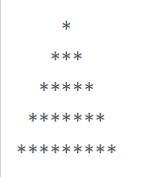
Patterns
Pyramid of Stars

Slide 80
Patterns
#include <stdio.h>
int main()
{
int row, c, n;
printf("Enter the number of rows in pyramid of stars to print\n");
scanf("%d", &n);
for (row = 1; row <= n; row++) // Loop to print rows
{
for (c = 1; c <= n-row; c++) // Loop to print spaces in a row
printf(" ");
for (c = 1; c <= 2*row - 1; c++) // Loop to print stars in a row
printf("*");
printf("\n");
}
return 0;
}

Slide 81

Patterns
Triangle Pattern/Half Pyramid

Slide 82
Patterns
#include <stdio.h>
int main()
{
int n, c, k;
printf("Enter number of rows\n");
scanf("%d", &n);
for (c = 1; c <= n; c++)
{
for(k = 1; k <= c; k++)
printf("*");
printf("\n");
}
return 0;
}

Slide 83
Patterns
1
1 2
1 2 3
1 2 3 4
1 2 3 4 5
Half Pyramid of Numbers

Slide 84
Patterns
#include <stdio.h>
int main() {
int i, j, rows;
printf("Enter the number of rows: ");
scanf("%d", &rows);
for (i = 1; i <= rows; ++i) {
for (j = 1; j <= i; ++j) {
printf("%d ", j);
}
printf("\n");
}
return 0;
}

Slide 85
*
* *
* * *
* * * *
* * * * *

Slide 86
#include <stdio.h>
int main()
{
int i,j,k;
for (i=1; i<=5; i++)
{
for (j=5; j>=i; j--)
{
printf(" ");
}
for (k=1; k<=i; k++)
{
printf("*");
}
printf("\n");
}
return 0;
}

Slide 87
1
2 3
4 5 6
7 8 9 10

Slide 88
#include <stdio.h>
int main()
{
int i,j,k,no=1;
for (i=1; i<=5; i++)
{
for (j=5; j>=i; j--) { printf(" ");
}
for (k=1; k<i; k++)
{
printf(" %d",no);
no++;
}
printf("\n");
}
return 0;
}

Slide 89
#include <stdio.h>
int main()
{
int i = 0;
do
{
i++;
if (i == 2)
continue;
printf("In while loop ");
} while (i < 2);
printf("%d\n", i);
}
In while loop 2

Slide 90
#include <stdio.h>
void main()
{
int k = 0;
for (k < 3; k++)
printf("Hello");
}
Compile time error

Slide 91
#include <stdio.h>
void main()
{
double k = 0;
for (k = 0.0; k < 3.0; k++);
printf("%lf", k);
}
3.000000

Slide 92
#include<stdio.h>
int main()
{
int a = 1;
do
{
printf("N");
a++;
} while(a = 5);
return 0;
}
N is printed infinite times

Slide 93
#include<stdio.h>
int main()
{
int x, y;
x = 5;
y = x++ / 2;
printf("%d %d",x, y);
return 0;
}
6 2

